Slide 1
Problems with JDBC
1.Databse dependent
2.We need to know proper query syntax
3.Closing resources like connection etc.
4.Every time we need to write the same query even though there is a single table
5. Process the result set.

Slide 2
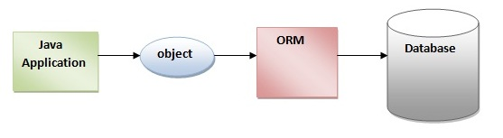
Hibernate Framework
Hibernate framework simplifies the development of java application to interact with the database. Hibernate is an open source, lightweight, ORM (Object Relational Mapping) tool.
An ORM tool simplifies the data creation, data manipulation and data access. It is a programming technique that maps the object to the data stored in the database.

Slide 3
Advantages of Hibernate Framework
1. Open source and Lightweight
2. Fast performance
3. Database Independent query
4. Automatic table creation
5. Simplifies complex join
6. Hibernate supports Query cache
7. Hibernate supports Inheritance, Associations, Collections

Slide 4
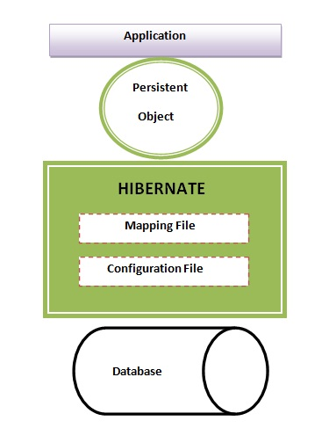
Hibernate Architecture

Slide 5
Elements of Hibernate
SessionFactory
The SessionFactory is a factory of session and client of ConnectionProvider
Session
The session object provides an interface between the application and data stored in the database.
Transaction
The transaction object specifies the atomic unit of work

